Slide 1

Harry Potter

Slide 2
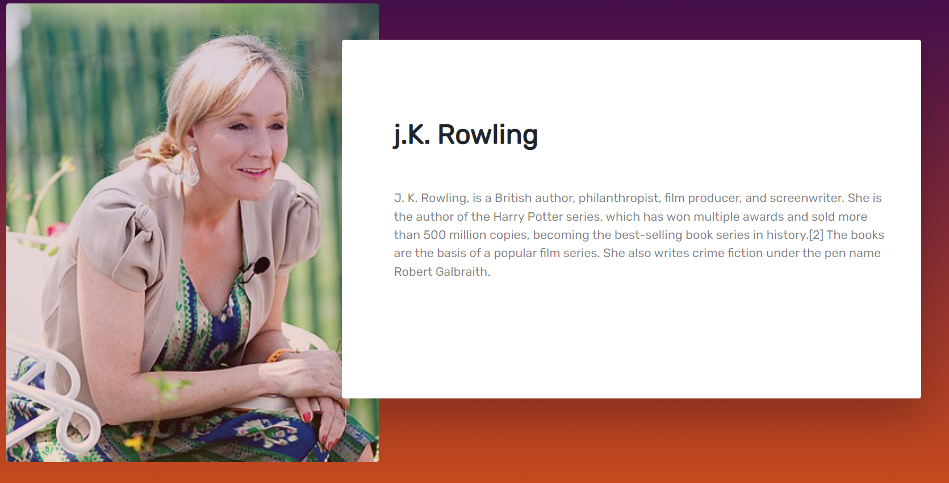
Second page contains information about author

Slide 3
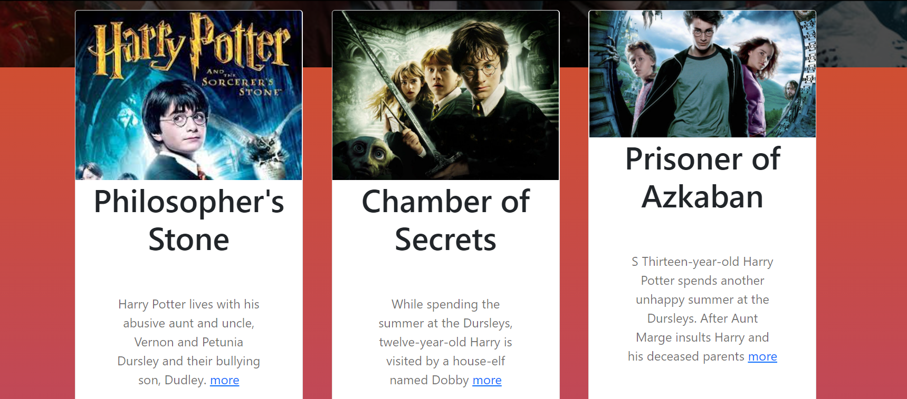
Добавить заголовок слайда 3
Third page contains information about parts of book but not full. If you want to read full one you have to click on more

Slide 4
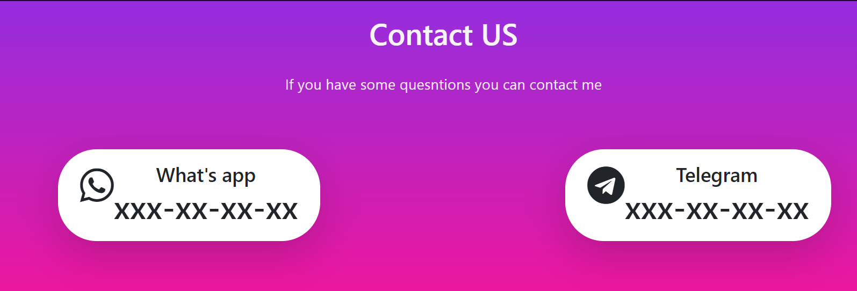
This is the contact page. Instead of xxx-xx-xx-xx you can write your nomber

Slide 5
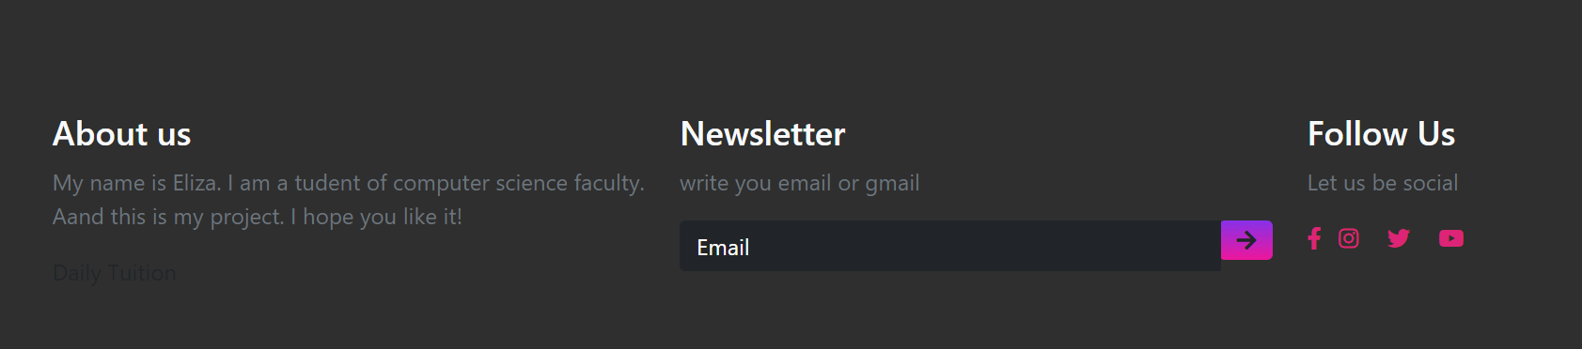

This is a footer. There a short information about me, follow us and gmail field
If you want to get to he home you should click on Home button in a navbar

Slide 6
What I used here
Font awesome for icons
Bootstrap
JavaScript
CSS
HTML

